Slide 1

Cyber Security
Lecture # 04

Slide 2
Lecture Overview
Internet
IP Address – IPV4 & IPV6
Uniform Resource Locator (URL)
Errors
Basic Network Utilities

Slide 3
INTERNET
A large number of networks that are connected to each other.
These various networks are simply connected to main transmission lines called backbones.
The points where the backbones connect to each other are called network access points (NAPs).
To connect the internet, log on to an Internet service provider (ISP).
That ISP connects either to another ISP or backbone provider.
One backbone provider connects to another at a Network Access Point (NAP).

Slide 4
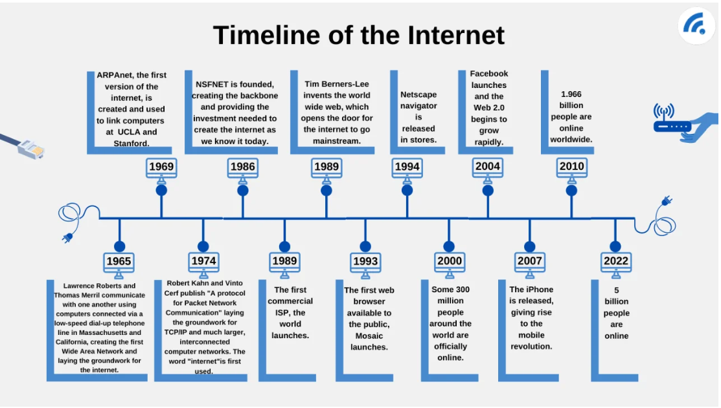

Slide 5
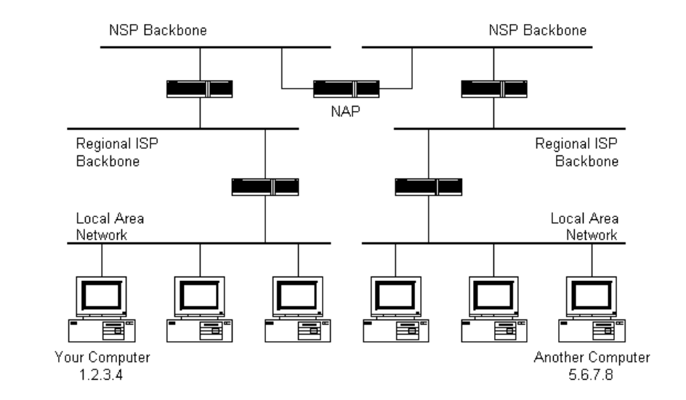

Slide 6
IP ADDRESS
IP (Internet Protocol) Addresses.
Necessary to navigate the Internet.
It is a unique identifier, like a Social Security number.
Usually in binary form.
Consists of four octets separated by decimals.
(An example would be 107.22.98.198.) Each of the three-digit numbers must be between 0 and 255.

Slide 7
PUBLIC VS PRIVATE ADDRESS
Public addresses are routable on the Internet.
Must be leased from an ISP.
No two public IP can be the same.
Private IP uses numeric code that is not unique and can be used again
Public IP is used to get internet service.
Public IP often begins with 39.102.230.17.
Private addresses are not routable on the Internet.
Must be leased from an ISP.
Private IP uses numeric code that is not unique and can be used again.
Private IP works only on LAN.
Private IP often begins with 10.102.230.17

Slide 8
IPv4 (Internet Protocol version 4)
Availability of IP addresses are not infinite.
An IP address is a series of four values, separated by periods.
These addresses are actually four binary numbers;
192.168.1.10
Each octet is a group of 8 bits (1 byte).
4 octets × 8 bits = 32 bits total.
2^32 = 4,294,967,296 (≈ 4.3 billion addresses)
Each octet can range from 0 to 255 (because 8 bits can represent 256 values).
An IPv4 address = 4 numbers (octets), each 0–255, separated by dots.
Example breakdown:
192 → 11000000
168 → 10101000
1 → 00000001
10 → 00001010

Slide 9
Converting binary numbers
Sample IPv4 addresses (decimal → binary)
10.0.0.1 00001010.00000000.00000000.00000001
127.0.0.1 (loopback) 01111111.00000000.00000000.00000001
192.168.1.1 (common private LAN) 11000000.10101000.00000001.00000001
172.16.0.1 (private range start) 10101100.00010000.00000000.00000001
8.8.8.8 (public DNS) 00001000.00001000.00001000.00001000

Slide 10
Class | IP Range (First Byte) | Use / Description
A | 0 – 126 | Extremely large networks. No Class A network IP addresses are left; all have been used.
B | 128 – 191 | Large corporate and government networks. All Class B IP addresses have been used.
C | 192 – 223 | The most common group of IP addresses. Your ISP probably has a Class C address.
D | 224 – 247 | Reserved for multicasting (transmitting different data on the same channel).
E | 248 – 255 | Reserved for experimental or research purposes.

Slide 11
Subnetting is simply chopping up a network into smaller portions.
For example, if you have a network using the IP address 192.168.1.X (where x is the address of a specific computer) then you have allocated 255 possible IP addresses.
CIDR (Classless Interdomain Routing) is another approach than define a subnet mask, you have the IP address followed by a slash and a number.
192.168.1.10/24 (basically a Class C IP address)

Slide 12
IPv6 (Internet Protocol version 6)
IPv6, as an extension of IPv4.
IPv6 utilizes a 128-bit address (instead of a 32-bit address),
IPv6 also utilizes a hex numbering method in order to avoid long addresses
An IPv4: 132.64.34.26.64.156.143.57.1.3.7.44.122.111.201.5.
An IPv6 hex address is 3FFE:B00:800:2::C.
IPv6 involves no subnetting, but it does use CIDR.
Supports DHCP, ( Dynamic Host Configuration Protocol), is used to dynamically assign IP addresses within a network.

Slide 13
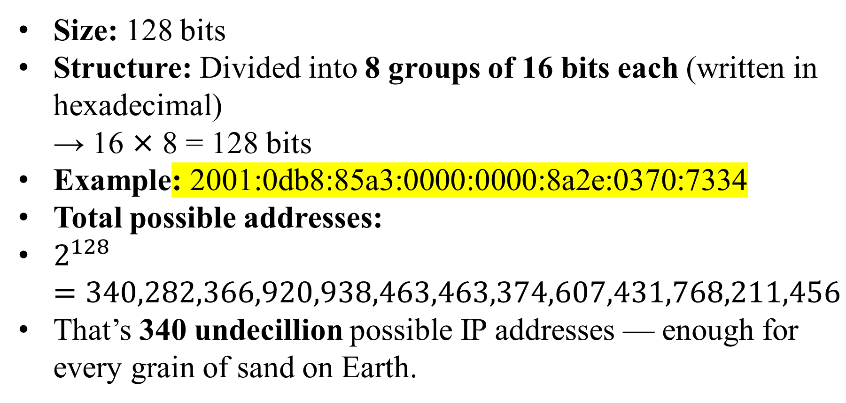
IPv6 (Internet Protocol version 6)
Size: 128 bits
Structure: Divided into 8 groups of 16 bits each (written in hexadecimal) → 16 × 8 = 128 bits
Example: 2001:0db8:85a3:0000:0000:8a2e:0370:7334
Total possible addresses:
$2^{128}=340,282,366,920,938,463,463,374,607,431,768,211,456$
That’s 340 undecillion possible IP addresses — enough for every grain of sand on Earth.

Slide 14
Uniform Resource Locators
A Uniform Resource Locator (URL) is the address used to access resources on the Internet — such as a webpage, image, or file.
The easy way to remember a Website.
Whenever you write www.google.com, it will be translated into IP Address by the Domain Name Server (DNS) Protocol.
Error messages can be sent by the web server.

Slide 15
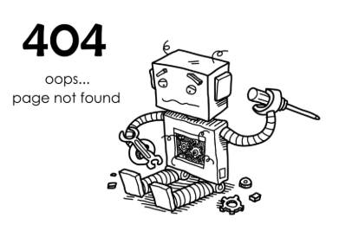
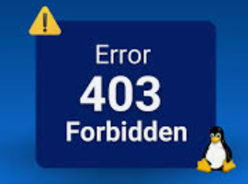
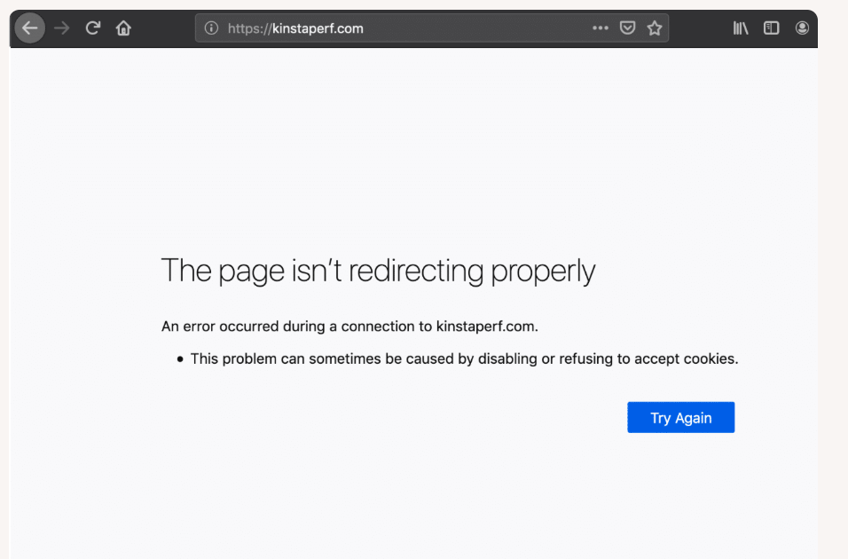
ERROR MESSAGES
100 series messages are informational.
200s are not seen because they indicate success.
300s are redirects.
400s are client errors.
500s are server errors.

Slide 16
Examples
204 No Content – successful, but no data to send.
302 Found – temporarily redirected.
304 Not Modified – cached version can be used.
401 Unauthorized – authentication required. 403 Forbidden – access denied. 404 Not Found – page doesn’t exist.
503 Service Unavailable – server temporarily overloaded or under maintenance. 504 Gateway Timeout – no response from upstream server.

Slide 17

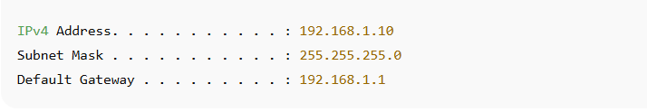
BASIC NETWORK UTILITIES
Ipconfig:
Your IP address (your computer’s “house number” on the network)
Subnet mask (helps define your local network range)
Default gateway (your router’s IP, the way to the internet)
Example
Output

Slide 18
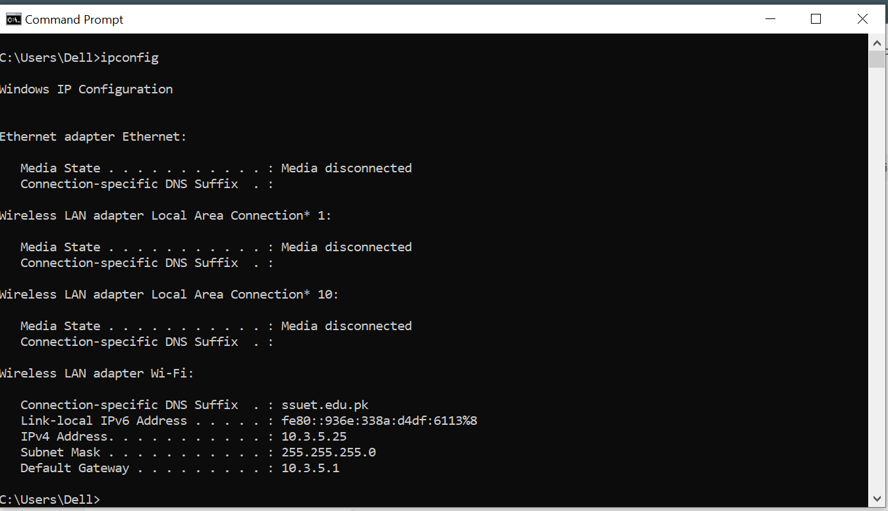

Slide 19

BASIC NETWORK UTILITIES
Ping
Ping tells if a system is connected to the network.
It sends test packets to another computer or website to see if it’s reachable and how fast it responds.
Example
Output

Slide 20
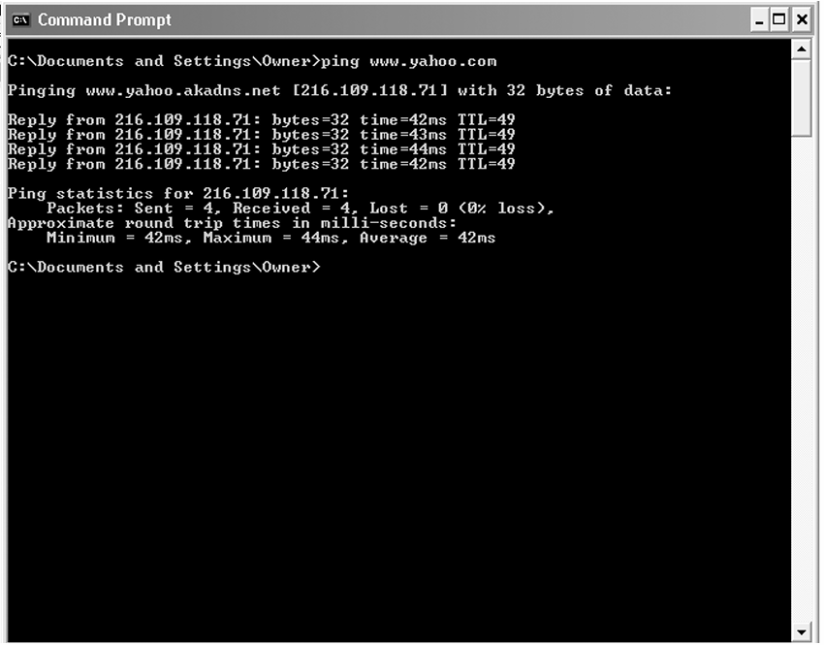
ping

Slide 21
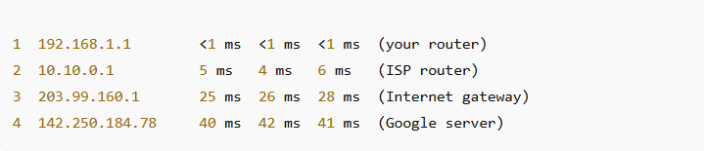
BASIC NETWORK UTILITIES
Tracert:
Shows every “hop” between host and destination address.
Trace the route to a destination
It shows each step (“hop”) your data takes from your computer to the destination.
Each hop represents a router your data passes through.
Example
Output

Slide 22
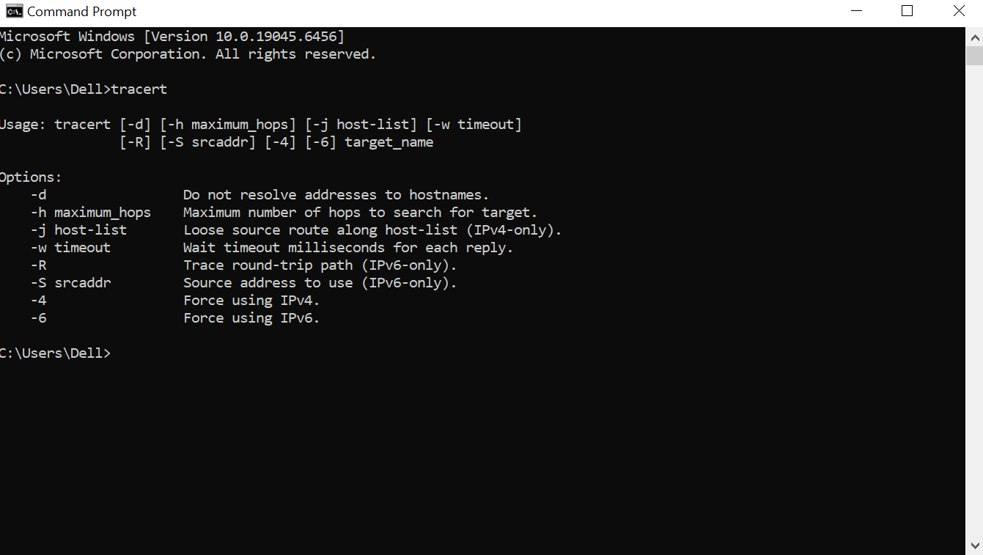

Slide 23

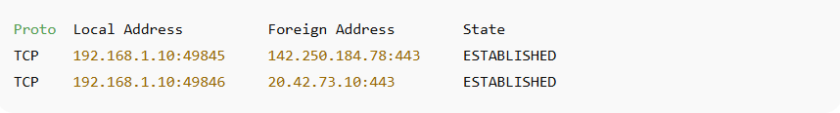
BASIC NETWORK UTILITIES
Netstat
Network status shows active connection.
It shows all active network connections, ports in use, and which programs are using them.
Example
Output

Slide 24
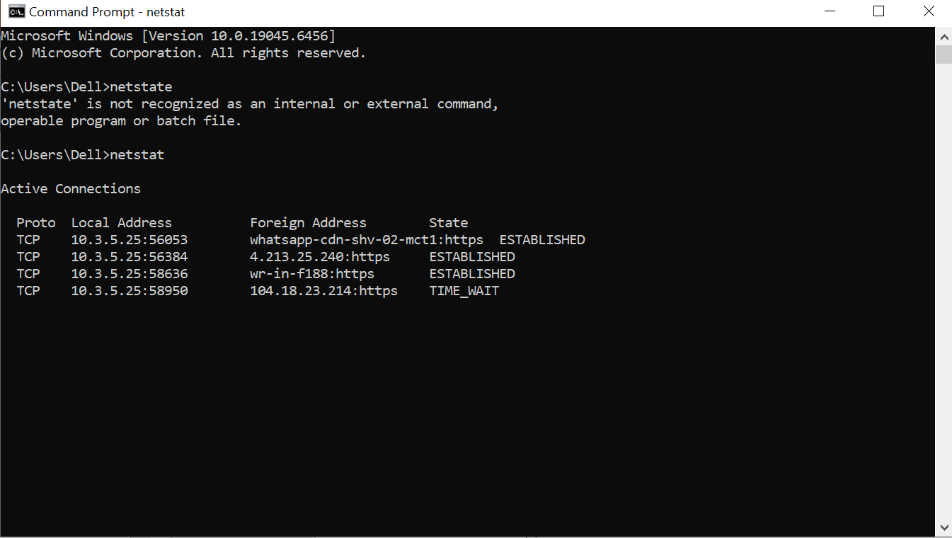

Slide 25
Thank you!
“Knowledge is the best program ever written”

